Slide 1

SSPMO Brown Bag
Date Goes here
Offshore Development Model - Overview

Slide 2
Participant’s ROI
Meeting Objective
Introduce project management model for remote development
Learn…
  What has changed
  Implications
  How these changes affect us

Slide 3
What has changed
  Global business model
  Part of a larger enterprise
  Outsourcing
  Higher expectations for sspmo

Slide 4

Implications for SSPMO
  Think and Act Global
    Value prop
    Requirements
    Development
    Ongoing support and operations
  Think (and manage) Virtually
  Be more proactive around
    Prioritization
    Value generation

Slide 5
Implications for SSPMO
  Think and Act Global
    Value prop
    Requirements
    Development
    Ongoing support and operations
  Think (and manage) Virtually
  Be more proactive around prioritization and value generation
Driven by:
  Global rationalization across
    Account management
    Products
    Operations
    Applications
    Technologies
  Optimal use of resources
    Onsite
    Offsite
    Offshore
Project economics need to consider these factors

Slide 6
Implications for SSPMO
  Think and Act Global
    Value prop
    Requirements
    Development
    Ongoing support and operations
  Think (and manage) Virtually
  Be more proactive around prioritization and value generation
Stronger need to help evaluate ideas- globally
  What problems are we solving, what questions are we answering?
  What value does that generate- globally?
    For Whom?
    What is it worth to them?
  What will it take for us to do this- globally?
  Is the proposed solution globally
    “right sized”?
    attainable?
    Maintainable?

Slide 7
Need to Understand Labor Cost Model
Budget
In-House
Budget Outsourced
In-House Indirect Costs
Other
Cost Savings
Facilities & Management
New Vendor Mgt Costs
Outsourced Indirect Costs
Vendor Profit Margin
Software
Amortized Transition & Wind Down Costs
Vendor Overhead
Invoice from Vendor
Hardware
Pass Through Costs
In-House Direct Costs
Outsourced Direct Costs
Vendor Direct Costs
Personnel
Retained Cost
In-House Costs
Indirect Costs
Outsourced Costs
Direct Costs

Slide 8
Implications for SSPMO
  Think and Act Global
    Value prop
    Requirements
    Development
    Ongoing support and operations
  Think (and manage) Virtually
  Be more proactive around prioritization and value generation
Driven by global Products and Solutions, including:
  Industry verticals
  Business processes / business issues
  Content, Solutions, Services
  Assets / Competencies
  Technology & Operations
Communication around project requirements is key.

Slide 9
Requirements Management
Requirements management will become more important to manage communications.
Problem
Problem
Space
Toll Gates 1&2
Needs
Solution Space
Toll Gates 3
Features
Traceability
The Product to Be Built
System
Requirements
Test Scripts
Design
User Docs

Slide 10
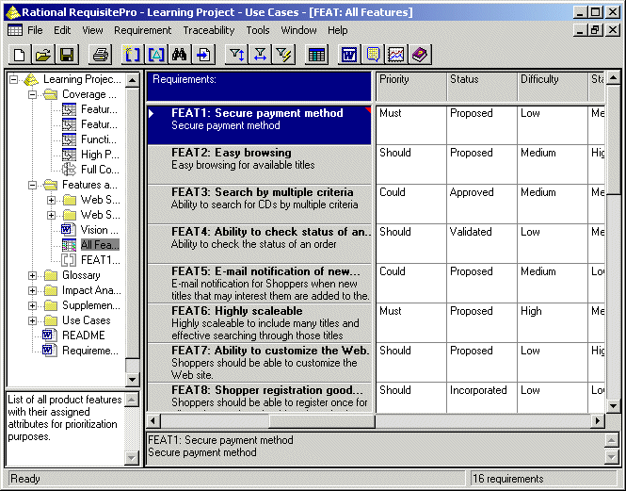
Requirements Management Tools

Slide 11
Implications for SSPMO
  Think and Act Global
    Value prop
    Requirements
    Development
    Ongoing support and operations
  Think (and manage) Virtually
  Be more proactive around prioritization and value generation
Decentralized / local
  Product management
  Process owners
  Subject matter experts
  SSPMO
Offsite/Offshore
  Development
  Support
  Operations
Managing project expectations is key.

Slide 12
Development roles cross the globe
Black Belt & Business Rep/SME
Project Manager/Team Lead
Application Architect
Designer
Developer
Test Lead
Tester
Test Automator
Integrator
Technical Writer/Documenter
SCM Engineer
Process Mentor
On Shore:- Activities taking place at current development centers – US and Europe. Identified in Yellow
Off Shore:- Activities taking place at new development with GOC in India. Identified in Green
On Shore / Offshore:- Activity taking place both onshore and offshore. Identified in Blue

Slide 13
Development process
Identify
Features
Facilitated by a consistent requirements management process. Need clear definitions of features, components, and development methodologies.
Release/
Phase
Planning
Identify
Components
Plan
Iteration
Specify
Feature
Design/
Refactor for
Feature
Implement
Feature
Quality
Control
Iteration
Testing
Customer
Focus Group
Team
Regroup
OnShore
Prepare
For
Deployment
Final
System
Test
Deploy
System
Offshore
Both

Slide 14
Implications for SSPMO
  Think and Act Global
    Value prop
    Requirements
    Development
    Ongoing support and operations
  Think (and manage) Virtually
  Be more proactive around prioritization and value generation
PM/BB’s need to consider:
  Including global representation early, such as:
    Transformation teams
    Operations teams
  Lessons learned from similar projects
  Formal PAR turnover
  Distance learning

Slide 15
Implications for SSPMO
  Think and Act Global
    Value prop
    Requirements
    Development
    Project management including ongoing support and operations
  Think (and manage) Virtually
  Be more proactive around prioritization and value generation
Project organization will be split across:
  Global IRI
  Sister divisions
  Outsource providers
Need to manage certain aspects of the project differently:
  What we build and how we build it
  Focus more attention on third party management
  Track financials using more sources
  Recognize the difference between hard & allocated $$

Slide 16
Implications for SSPMO
  Think and Act Global
    Value prop
    Requirements
    Development
    Project management including ongoing support and operations
  Think (and manage) Virtually
  Be more proactive around prioritization and value generation
  Important Metrics
    ROI
    Milestones
    Costs
    Benefits, timing and cost variance
    Cycle time for key project deliverables (i.e., design docs, coding, test results, etc.)
    Defects/Issues outstanding

Slide 17
Current Technology Organization
Technology
IRI –
North America
Europe
IRI GOC
RPM GDC
PAR
ITO
New Factory
Third
Party
Involvement
Symphony
Sister
Company
Symphony
Sister
Company
Third
Party
Involvement
Third
Party
Involvement
Third
Party
Involvement
SME’s
Design
Integration
Security
Project development
RPM development
RPM integration
AS development
Maintenance
Break-fix
Small enhancements
Infrastructure
Architecture
Communication
Disaster recovery
New factory projects
Integration
From Local
To Global / Virtual

Slide 18
Engagement Model – Sister Companies
 | Procurement Owner | Development Model | Process Owner | Process Design | Time Tracking | Finance
Symphony RPM | Marshall Gibbs | Adapted Remote Dev. Model | Nigel | Tom Edwards/ RPM | ? | Cross comp. charge
Symphony Services (GDC) | Marshall Gibbs | Adapted Remote Dev. Model | ? | Tom Edwards/ GDC | Symphony tracking | Cross comp. charge
Global Operations Center (GOC) | NA | Remote Development Model | Mahinder Mathrani | Tom Edwards | IRI time tracking | Cross comp. charge

Slide 19
Engagement Model – Third Parties
 | Procurement Owner | Development Model | Process Owner | Process Design | Time Tracking | Finance
HCL – AMO | Marshall Gibbs | PAR/PMR | Tom Phalen | Seza Tapban | IRI time tracking | Invoice
Other AMO | Various, includes Brent Wilder | Defined SOW and SLA’s | Various | Project team (i.e., Pachyderm) | Various | Invoice
Other Contracted Services | Various, includes Brent Wilder | As specified in RFP and Proposal | Various | Project team | Various | Invoice

Slide 20
Remote Development by Area
 | Symphony RPM | Symphony Services (GDC) | Global Operations Center (GOC) | HCL – AMO | Other AMO | Other Contracted Services
Visualization
Data Integration
Pachyderm
On Demand Factory
Legacy Support (PAR)
Software (i.e., Cofinity/ Apollo)
Corporate Business Info Sys. (CBIS)
Consulting-TMC
Consulting - AIG
Consulting - BPM

Slide 21
Implications for SSPMO
  Think and Act Global
    Value prop
    Requirements
    Development
    Ongoing support and operations
  Think (and manage) Virtually
  Be more proactive around prioritization and value generation
Deliver solutions that fulfill client needs
  From requirements to implementation,
  Inclusive of operational design and,
  Ongoing measurements
Prioritize features within a release
Align efforts globally around releases, including new development and enhancements

Slide 22

Our response to these changes
Global SSPMO
Renewed Focus
North America
  Process refinement
  Roles and responsibilities
Europe
  Scott Kormis is assembling the Six Sigma Team
  Starting up an EQC
India
  Mahinder Mathrani is assembling the Six Sigma Team
  BPMS processes are being established from the get go
  SSPMO building operations transformation plans, SLA’s and training

Slide 23
Renewed Focus - Global SSPMO Vision
Imagine:
  Creative curiosity to dig into the issues/challenges (and feeling empowered to do so)
  Passionate about the process to make it real
Solve:
  Resourceful in bringing together the right people at the right time with the right tools to define robust solutions
  Personally accountable (and creates the same ownership with team) for the solutions
Build:
  Creates and atmosphere of teamwork (to include suppliers and customers) centered on creating value for the customer
  Commitment and process to deliver on expectations
Lead:
  Open in communications, with an unrelenting spirit of optimism
  Displaying the edge and energy to deal with the speed of change

Slide 24
Areas to Grow
Deeper understanding of requirements management (process and tools)
Inclusion of Business Analysis responsibilities as part of our established Black Belt role
Tool training on Reqpro
Deeper understanding of contract and procurement (third party) management
Tighter relationship between projects and PMR’s
More refinement of the remote development model

Slide 25
Recap and Next Steps
We talked about
  What’s changed
  Implications
  How these changes affect us

